Slide 1



Customer Churn EDA

Slide 2

Total Customers
$ 440.8 K
Churners
Not Churners
$ 250 K
$ 190.8 K

Slide 3


Total Not Churners Spend
Total Churners Spend
$ 143 M
$ 145 M

Slide 4
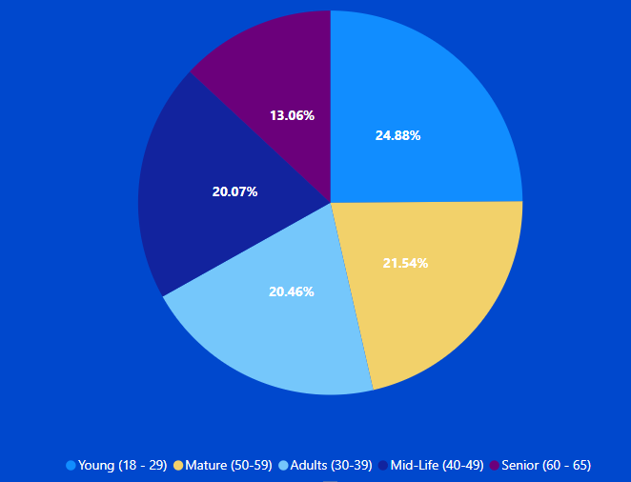
Age
As you can see almost half of the Curners in the Young (18-29) group

Slide 5

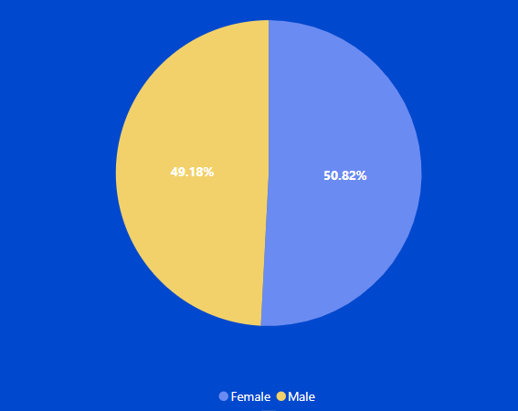
Customers Gender
Gender
Most of customers are Male
The most of churners are females customers

Slide 6
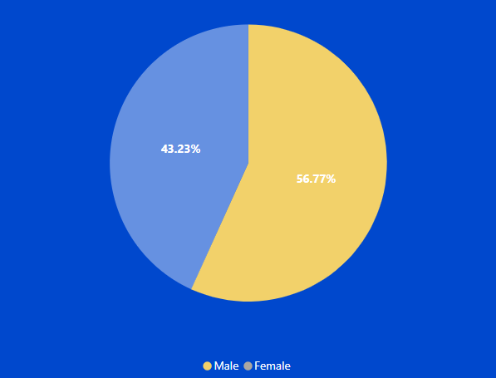
Churn Gender
Gender
Most of customers are Male
The most of churners are females customers

Slide 7
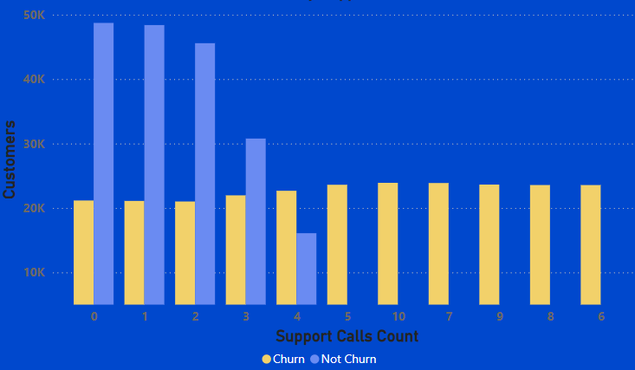
3%
Support Calls
There is an inverse relationship between customers who experience churn and customers who contact customer service. The more times the customer contacts, the more likely they are to experience churn.
The percentage of churners increases as the number of calls increases.

Slide 8
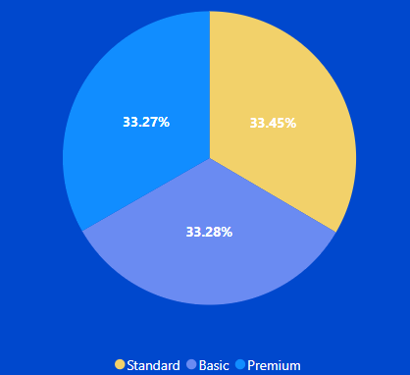
Subscribtion Type
Almost half of customers with annual and quarterly contracts churn, but customers with monthly contracts all churn

